Slide 1
NAVIGATION (part 2)
WEEK 3
Advanced Native Mobile Programming
1604C062
Informatics Engineering - Universitas Surabaya

Slide 2
HIGHLIGHTS
popUpTo & popUpToInclusive
Navigation Component with BottomBar Navigation
Navigation Component with Dialog
Navigation Component with Drawer
Please re-open previous week project to follow this week tutorial

Slide 3
PopUp
popUpTo & popUpToInclusive

Slide 4
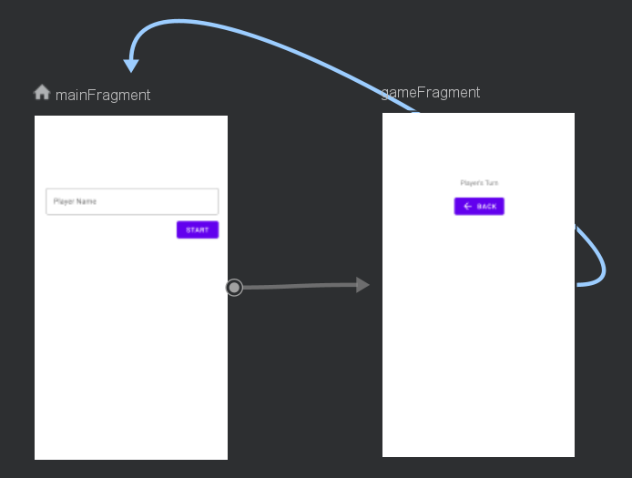
POPUP
Lets start with an example
Two fragments. Main can navigate to game fragment, vice versa.

Slide 5
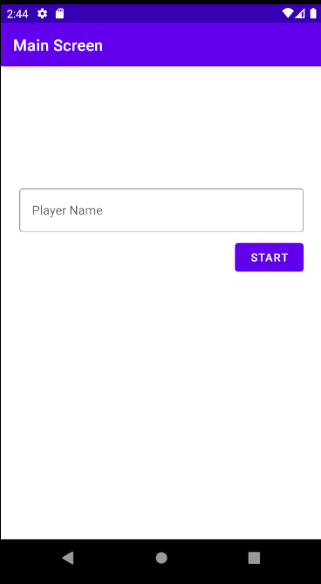
POPUP
MainFragment serves as the “default” or “main” fragment
The initial backstack only have one fragment (main)
MainFragment
BackStack

Slide 6
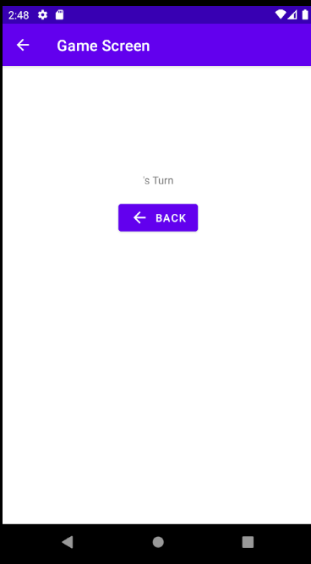
POPUP
Player then presses start button (navigate to game fragment)
Now backstact contain to fragments. What happen if back button pressed?
Game Fragment
MainFragment
BackStack

Slide 7
POPUP
Player presses back button (soft) or hard or call navigate codes
The default behavior is a new instance of destinations fragment created. Now backstack contains three fragments with two instances of MainFragment
MainFragment
Game Fragment
MainFragment
BackStack

Slide 8
POPUP
And then player presses start button (navigate to game fragment)
Another instance of GameFragment created on backstack. How to change this behavior?
Game Fragment
MainFragment
Game Fragment
MainFragment
BackStack

Slide 9
USING POPUPTO
popUpTo attributes can be applied to an action (arrow) to remove backstack content until it reaches the destination fragment
example:
Let’s say there are three fragments currently on the backstack. Next from fragment C it can navigate to Fragment A
Fragment C
Fragment B
Fragment A

Slide 10
USING POPUPTO
Using popUpTo fragmentA, it will popup every item on backstack until it reaches the destination (fragmentA)
Fragment C
Fragment C & B are popped out from backstack. Fragment A remains active on backstack
Fragment B
Fragment C
Fragment B
Fragment A

Slide 11
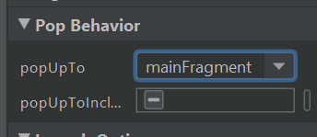
LET’S TRY IT
Open your navigation graph, click arrow (action) from game fragment to main fragment. Change the popUpTo attributes to mainFragment

Slide 12
USING POPUPTOINCLUSIVE
popUpToInclusive attributes will remove each stack object until it reaches the destination, including the destination itself
Fragment C
Fragment A is also popped out of the backstack. Android will create a new instance of Fragment A. This is useful if you need to get latest data to fragment A (from server maybe?)
Fragment B
Fragment C
Fragment B
Fragment A
Fragment A

Slide 13
BottomBar
With navigation component

Slide 14
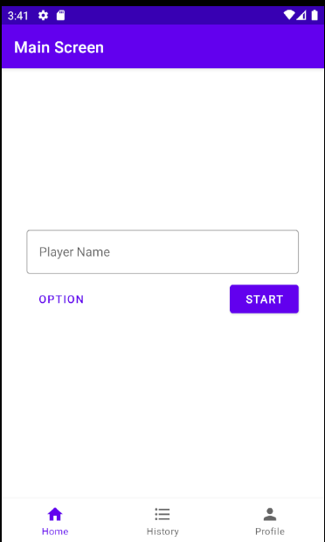

BOTTOM BAR NAVIGATION
Previously in Native course, you need at least three things: ViewPager, BottomBar Navigation, Kotlin codes that manually handle the navigation

Slide 15
BOTTOM BAR WITH NAV COMPONENT
First we need three icons for bottom bar navigation.
Right click on res > new > Vector assets, and then create three icons:
home
list
person

Slide 16



FRAGMENTS
Each bottom bar icon will navigate to its respective fragments
= MainFragment
= HistoryFragment
= ProfileFragment

Slide 17
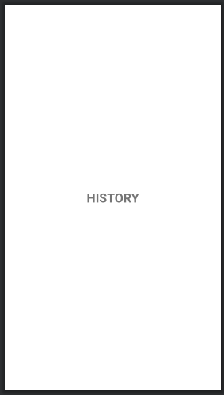
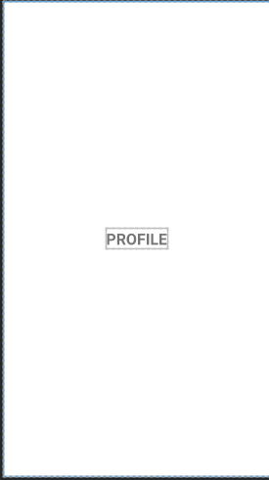
CREATE FRAGMENTS
Create two new fragments, name them HistoryFragment and ProfileFragment
Make sure you follow similar steps in week 2 to cleanup codes in fragment class
For each fragment, set the layout like screenshot on the right

Slide 18
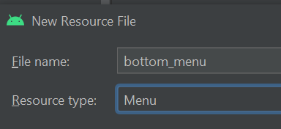
CREATE BOTTOM MENU RESOURCE
Next step is creating bottom bar menu resource file
Right click on res > new > Android resource file
Fill in file name to “bottom_menu”
Choose resource type as “menu” (this will generate menu folder within res)
Press OK

Slide 19
CREATE BOTTOM MENU RESOURCE
Drag three Menu Items and set attributes as indicated here:
Home Icon
Id = itemHome
Icon = drawable home
showAsAction = always
Title = home
History Icon
Id = itemHistory
Icon = drawable list
showAsAction = always
Title = history
Profile Icon
Id = itemProfile
Icon = drawable person
showAsAction = always
Title = profile

Slide 20
ADD BOTTOM NAVIGATION
Next step is adding bottom navigation to MainActivity layout
Open activity_main.xml
Drag and drop BottomNavigationView component
Change id to “bottomNav”
Set menu to “@menu/bottom_menu”
Set layout_width = match_constraint
Set layout_height = wrap_content
Constrained to very bottom of screen

Slide 21
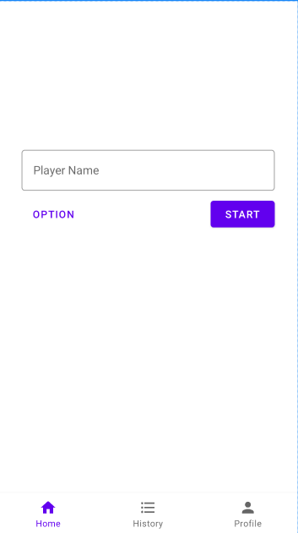
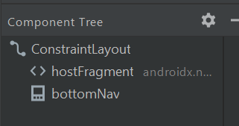
ADD BOTTOM NAVIGATION

Slide 22
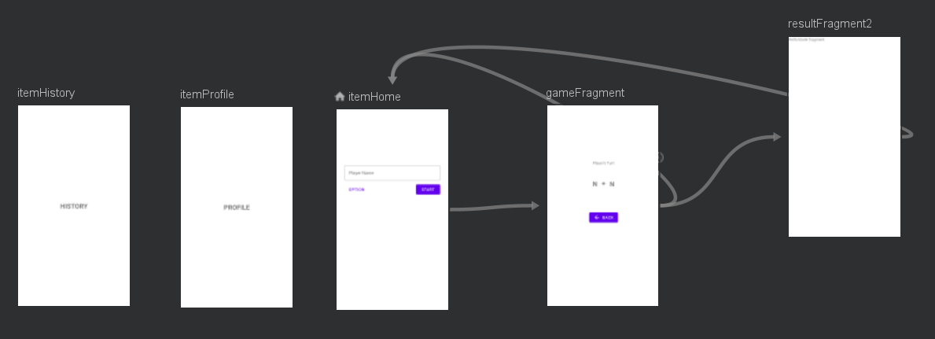
UPDATE NAVIGATION GRAPH
Next step, we should update navigation graph by adding new destinations (fragment profile and history). Open game navigations and add two destinations

Slide 23
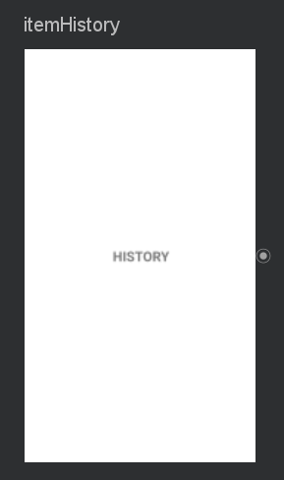
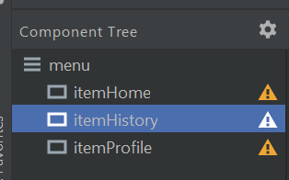
!! IMPORTANT !!
To create a connection between navigation controller with navigation bar you need to set same ID on both of Destinations Object and Menu Item ID

Slide 24
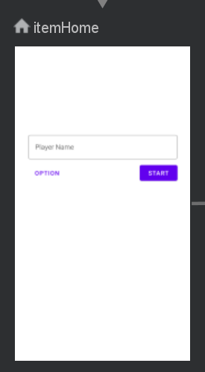
!! IMPORTANT !!
It means that for MainFragment destinations you should rename the id as “itemHome”

Slide 25
NO ACTION/ARROW
For this case, its unnecessary to draws connection/arrow between those fragments. Bottom bar navigation allows user to jump in various fragment without specific flow order.

Slide 26
ESTABLISH CONNECTION
Final step is to establish connection between nav controller and the bottom bar. Remember: nav controller holds navigation host that relies on navigation graph.
Open main activity, add following codes inside onCreate method:
bottomNav.setupWithNavController(navController)

Slide 27

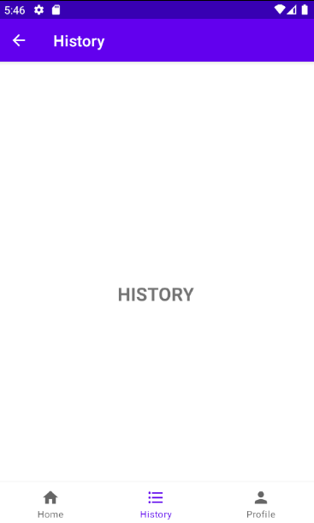
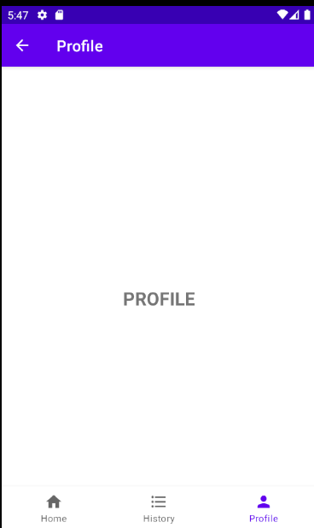
RESULTS
Try to click different menu

Slide 28
Dialog
With navigation component

Slide 29
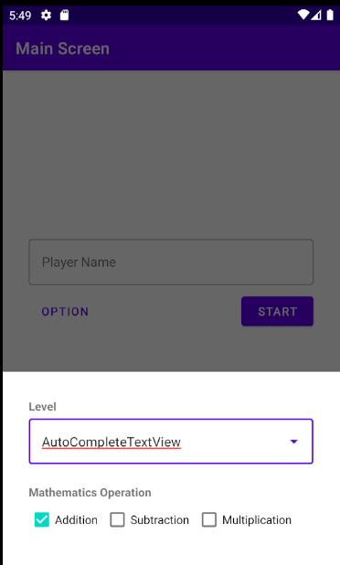
DIALOG
Previously in Native course, you use AlertDialog builder or custom dialog fragment to show a dialog

Slide 30
DIALOG FRAGMENT
First step, of course we need dialog fragment. Create a new fragment and set name as OptionFragment
Extend the fragment class to
class OptionFragment : BottomSheetDialogFragment() {
BottomSheetDialogFragment just fundamentally acts as regular dialog, but will slide up from bottom screen (with animation)

Slide 31
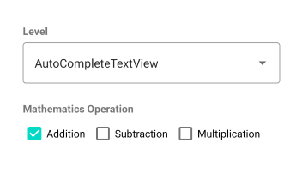
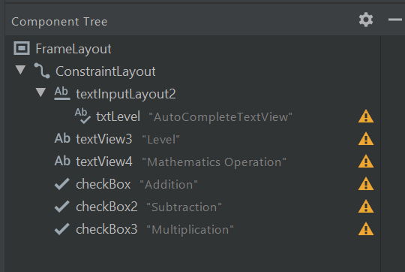
DIALOG FRAGMENT LAYOUT
Create layout based on reference below

Slide 32
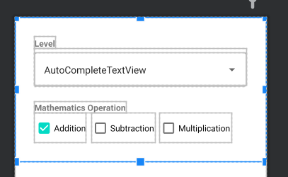
DIALOG FRAGMENT LAYOUT
ConstraintLayout parent
Layout_width = match_parent
Layout_height = wrap_content
Three checkboxes
Margin_bottom = 32 dp

Slide 33
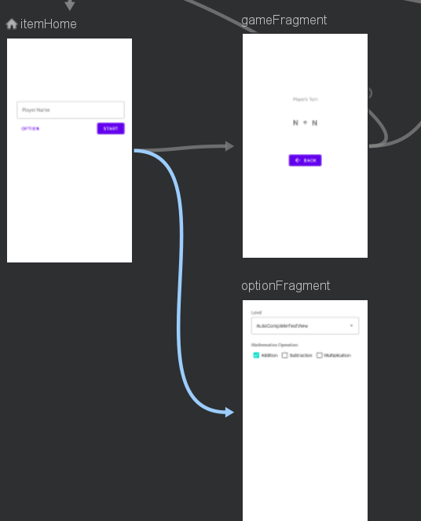
UPDATE NAVIGATION GRAPH
Open navigation graph, add dialog optionFragment as new destination
Draw arrow/actions from itemHome (main Fragment) to optionFragment
As usual rename actions as “actionOptionFragment”
Don’t create opposite arrow from optionFragment, because dialog should close itself if user tap on outside of dialog body

Slide 34
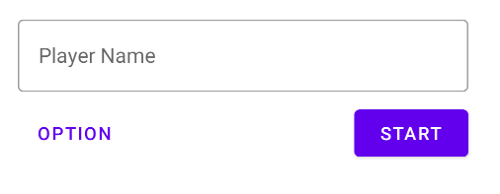
ADD OPTIONS BUTTON
To invoke the dialog, we need a button in main fragment layout.
Button
Id = btnOption
Style = @style/Widget.MaterialComponents.Button.TextButton

Slide 35
TRIGGER THE DIALOG
To trigger the dialog, it doesn't requires alert dialog. Use the same method like navigating to other screens
In MainFragment.kt (onViewCreated), add following codes
btnOption.setOnClickListener {
val action = MainFragmentDirections.actionOptionFragment()
Navigation.findNavController(it).navigate(action)
}

Slide 36
RESULT
Click option button
The dialog should appear from bottom screen
Click on outside of dialog body to close the
dialog

Slide 37
Drawer
With navigation component

Slide 38
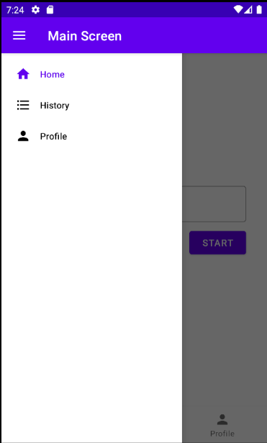
NAV DRAWER
Previously in Native course, you must implement navigation manually for each menu items on drawer

Slide 39
NAVIGATION DRAWER
Navigation drawer can co-exist with bottom navigation
To create a navigation drawer, the first step is to wrap your layout under DrawerLayout component
This need to be done manually, in XML codes Note: please refer to Native course for more information about drawer layout

Slide 40

NAVIGATION DRAWER
Open activity_main.xml, click on button to switch view from design to XML codes. Write following codes at the top of the layout.
<?xml version="1.0" encoding="utf-8"?>
<androidx.drawerlayout.widget.DrawerLayout xmlns:android="http://schemas.android.com/apk/res/android"
xmlns:app="http://schemas.android.com/apk/res-auto"
xmlns:tools="http://schemas.android.com/tools"
android:id="@+id/drawerLayout"
android:layout_width="match_parent"
android:layout_height="match_parent"
android:fitsSystemWindows="true">
Cut paste these three xml codes from Constraint layout tags
This drawer layout id is “drawerLayout”

Slide 41
NAVIGATION DRAWER
<androidx.drawerlayout.widget.DrawerLayout . . .>
<androidx.constraintlayout.widget.ConstraintLayout
android:layout_width="match_parent"
android:layout_height="match_parent"
tools:context=".MainActivity">
....
</androidx.constraintlayout.widget.ConstraintLayout>
</androidx.drawerlayout.widget.DrawerLayout>
Wrap constraint layout within drawer layout tags
Enclosed drawer layout tag

Slide 42
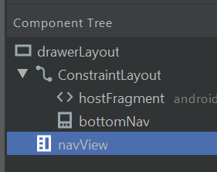
NAVIGATION VIEW
Switch back to design view, drag and drop a navigation view component, and arrange it like following screenshot
Navigation View
Id = navView
layout_gravity =”start”
layout_width = wrap_content
layout_height = match_parent
Menu = @menu/bottom_menu
IMPORTANT! Navigation View must be placed on the bottom of layout. Not under Constraint layout

Slide 43
NAVIGATION VIEW
Notice that navigation view is using the same menu resource files as bottom navigation bar.
It means that the drawer will render the same menu structure and item as the navigation bar. Therefore, no need to update navigation graph.
Of course you can create separate menu for the drawer
For simplicity purpose, we don't use a navigation header during the tutorial

Slide 44
ESTABLISH CONNECTION
Final step is to establish connection between drawer & navigation view to navigation controller
Open MainActivity.kt, write following codes under onCreate:
navController = (supportFragmentManager.findFragmentById(R.id.hostFragment) as NavHostFragment).navController
NavigationUI.setupActionBarWithNavController(this, navController, drawerLayout)
NavigationUI.setupWithNavController(navView, navController)
bottomNav.setupWithNavController(navController)
This refer to drawer layout component
Navigation view also need to be handled by NavController

Slide 45
ESTABLISH CONNECTION
Update onSupportNavigateUp method:
override fun onSupportNavigateUp(): Boolean {
return NavigationUI.navigateUp(navController, drawerLayout) || super.onSupportNavigateUp()
}
Previously this set to null (without drawer)
This code automatically detects if the user is on the top level of backstack: the drawer icon will show instead of the back button

Slide 46
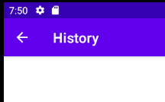
RESULT
Navigation Controller automatically handles item click navigation
If user is not in top level of backstack then back icon will displayed
Remember that you must use same id both for navigation graph destinations and menu item

Slide 47
THANKS!
DO YOU HAVE ANY QUESTION?
andre@staff.ubaya.ac.id
Please keep this slide for attribution.

Slide 48


